Slide 1


HOUSING PRICE PREDICTION PROJECT
Submitted to :
Mohd Kashif, Flip Robo Technologies
Submitted by:
CHETHANA M

Slide 2
Introduction
Houses are one of the necessary need of each and every person around the globe and therefore housing and real estate market which is one of the major contributors in the world’s economy.
Data science comes as a very important tool to solve problems in the domain to help the companies increase their overall revenue, profits, improving their marketing strategies and focusing on changing trends in house sales and purchases.
A US-based housing company named Surprise Housing has decided to enter the Australian market. The company uses data analytics to purchase houses at a price below their actual values and flip them at a higher price. For the same purpose, the company has collected a data set from the sale of houses in Australia. This data is used to predict the price of the houses.
Our goal is to build a model using Machine Learning in order to predict the actual value of the prospective properties and decide whether to invest in them or not. For this company wants to know:
• Which variables are important to predict the price of variable?
• How do these variables describe the price of the house?

Slide 3
Goals and Objective
The purpose of this project is to document the process I went through to create my predictions on Housing price Prediction.
The Objective of this projective is to build a regression model that could successfully determine prices of the houses in Australia with the given dataset.

Slide 4
Software required
TOOLS USED
Jupyter Notebook
LIBRARY USED
Analysing : Numpy, Pandas, Sci-kit Learn
Visualization : Matplotlib, seaborn

Slide 5
Linear Regression
In this project we have used multiple algorithm to predict the price but ideal we will see what is Linear Regression.
In statistics, linear regression is a linear approach for modelling the relationship between a scalar response and one or more explanatory variables (also known as dependent and independent variables). The case of one explanatory variable is called simple linear regression, for more than one, the process is called multiple linear regression.
Apart from Linear Regression the other algorithms used in this project are :
Support vector Regressor
Decision Tree Regressor
KNeighbors Regressor
Ridge and Lasso Regressors
Random Forest Classifier

Slide 6
Implementation
Importing the necessary libraries
Importing the dataset
Cleaning and analysing the dataset
Building the models
Comparing the scores of the models and picking the best model
Saving the final model and making use of it for prediction

Slide 7
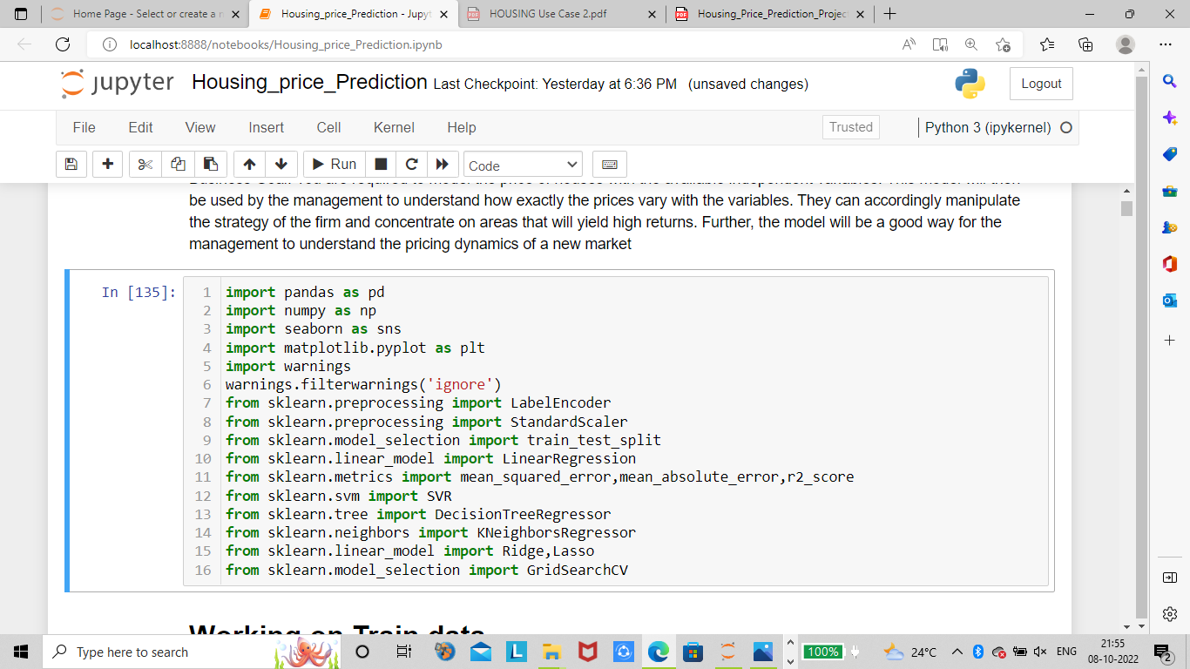
Importing the necessary libraries

Slide 8
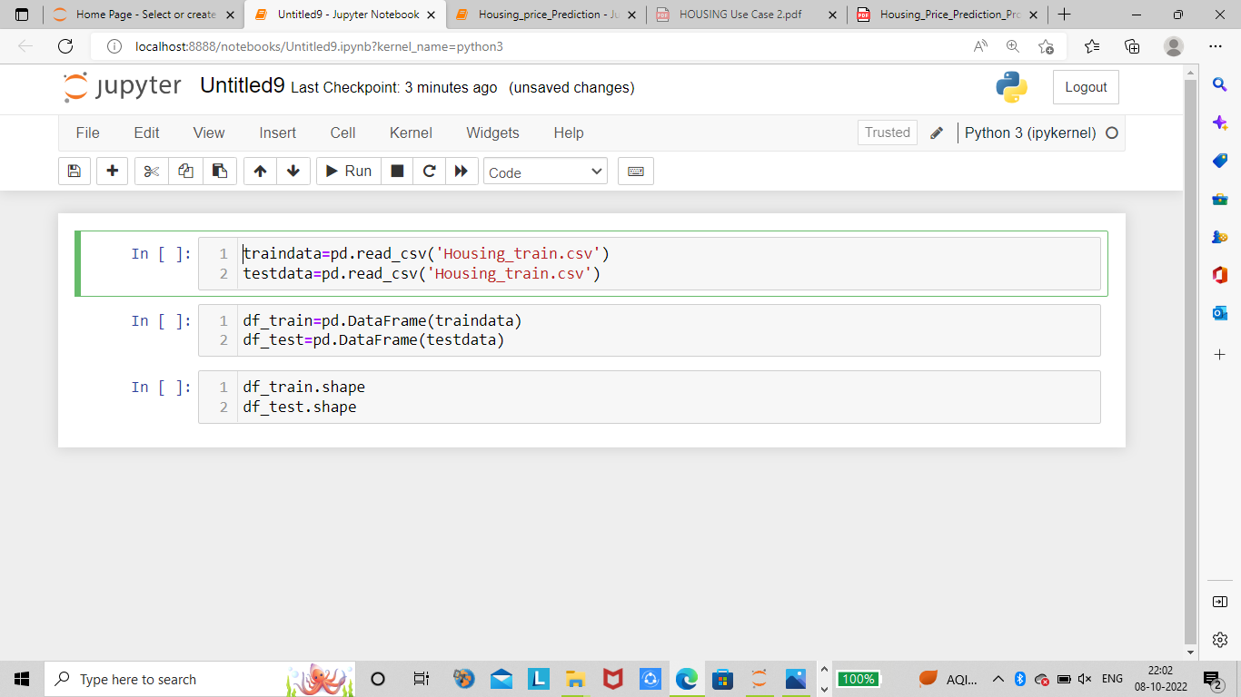
Read and explore the data
Train data = 1168 rows, 81 columns
Test data = 292 rows, 80 columns

Slide 9
Cleaning and Analysing the data
In this process there were presence of missing data, outliers, columns that doesn’t create any impact on output variable. Missing values in few columns were filled with NA based on assumptions made in EDA and rest were treated with simple imputer. Using Label encode the categorical data is encoded. The outliers were removed from continuous data using z-score method. Skewness was checked for the datasets and removed the skewness using ‘yeo-johnson’ method. Multicollinearity was checked and few columns were dropped which were creating high multicollinearity in the dataset.

Slide 10
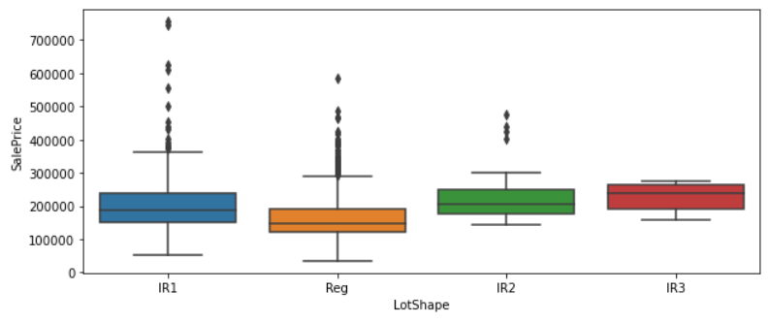
Data Visualization
Let us look into few example graphs about how input variable affects price of the house.
From the above plot we can observe that the price is highest for those properties whose shape is Slightly irregular.

Slide 11
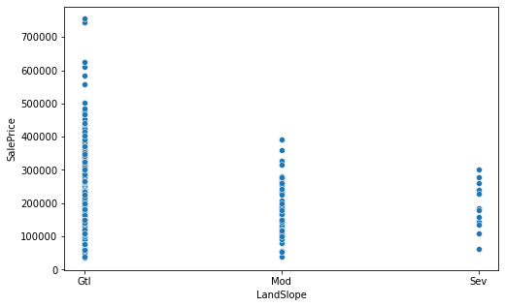
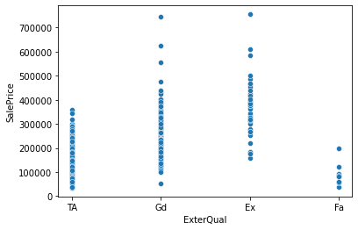
From the above plot we can see that the Price of the property is high for those which has the external quality rating as Good and Excellent.
From the above plot we can observe that the Price of the property is highest for those which has Gentle slope.

Slide 12
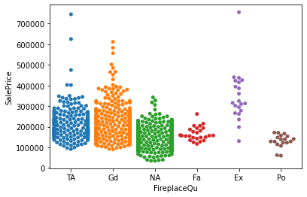
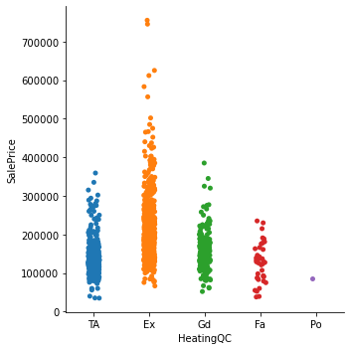
From the above plot we can observe that the price of the property is high for those which has Fire place quality as Excellent and Average.
From the above plot we can observe that the Price of the property is high for those which has Heating quality is Excellent.

Slide 13
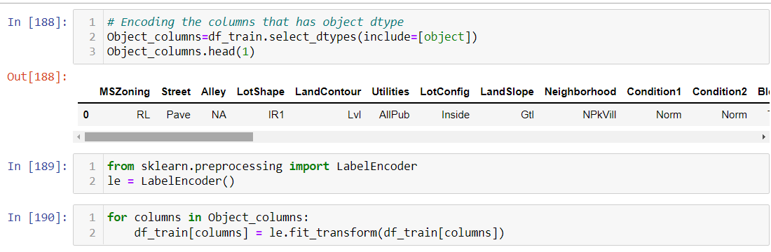
Object dtype Data in the dataset that is encoded
The variables which had the Object dtypes are identified and transformed into integer dtype using Label Encoder as shown in the above picture

Slide 14
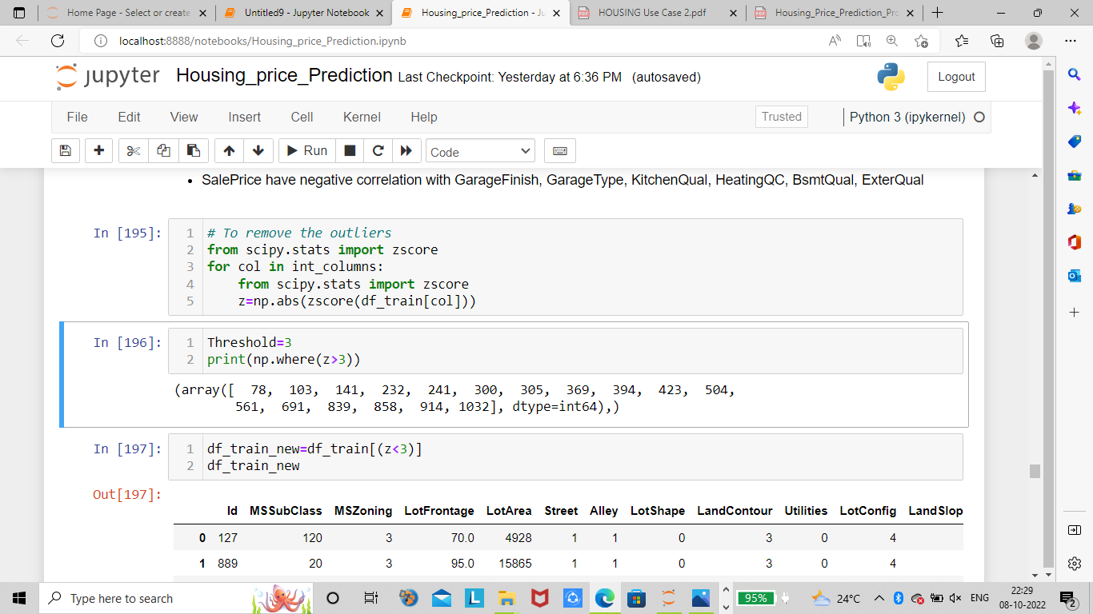
Removing Outliers

Slide 15
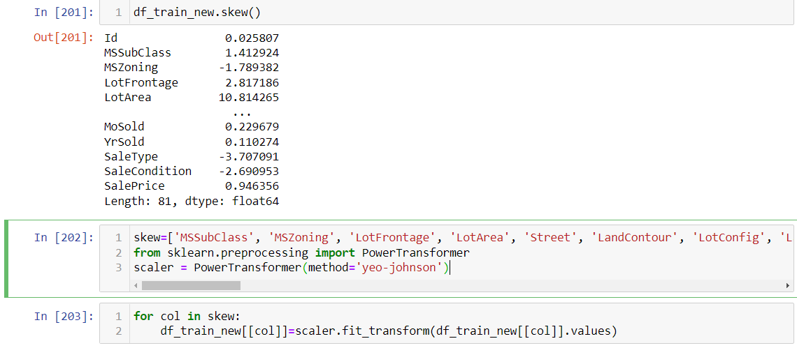
Removing skewness of the data

Slide 16
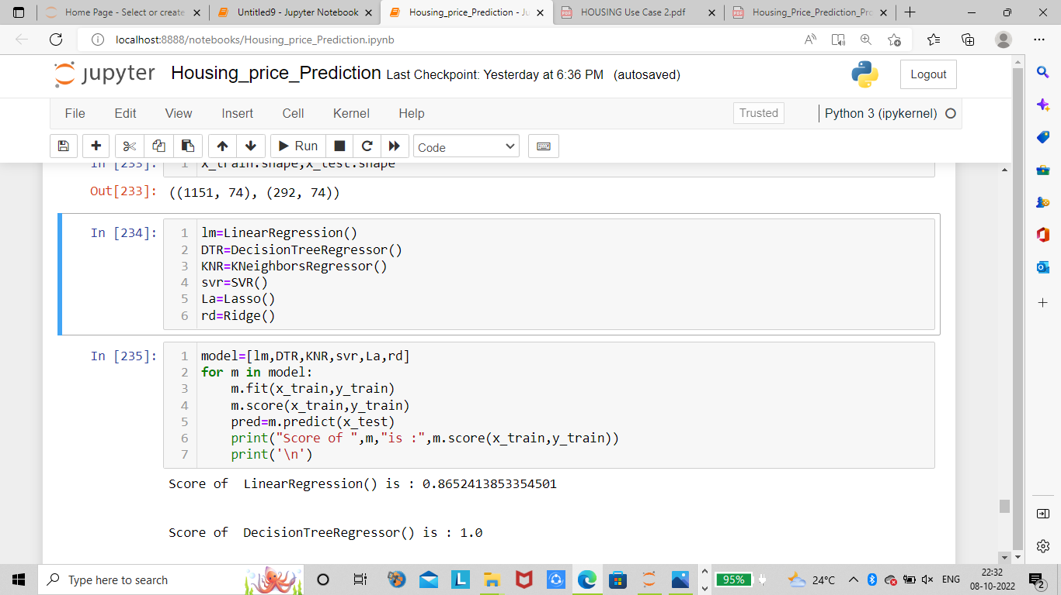
Building multiple models using the above mentioned algorithms
LinearRegression() : 0.8652413853354501
DecisionTreeRegressor() : 1.0
KNeighborsRegressor() : 0.731103114938408
SVR() : -0.04677351659363316
Lasso() : 0.8652413443715304
Ridge() : 0.8652406950756619

Slide 17
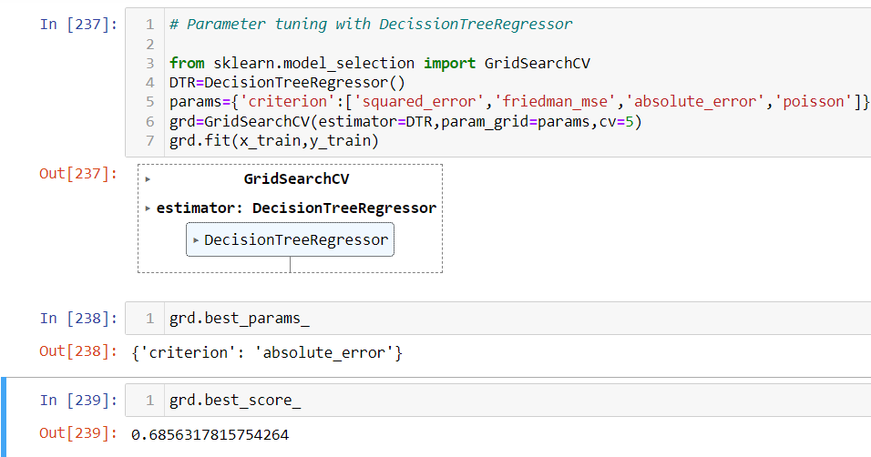
Parameter tuning on Decision Tree Classifier

Slide 18
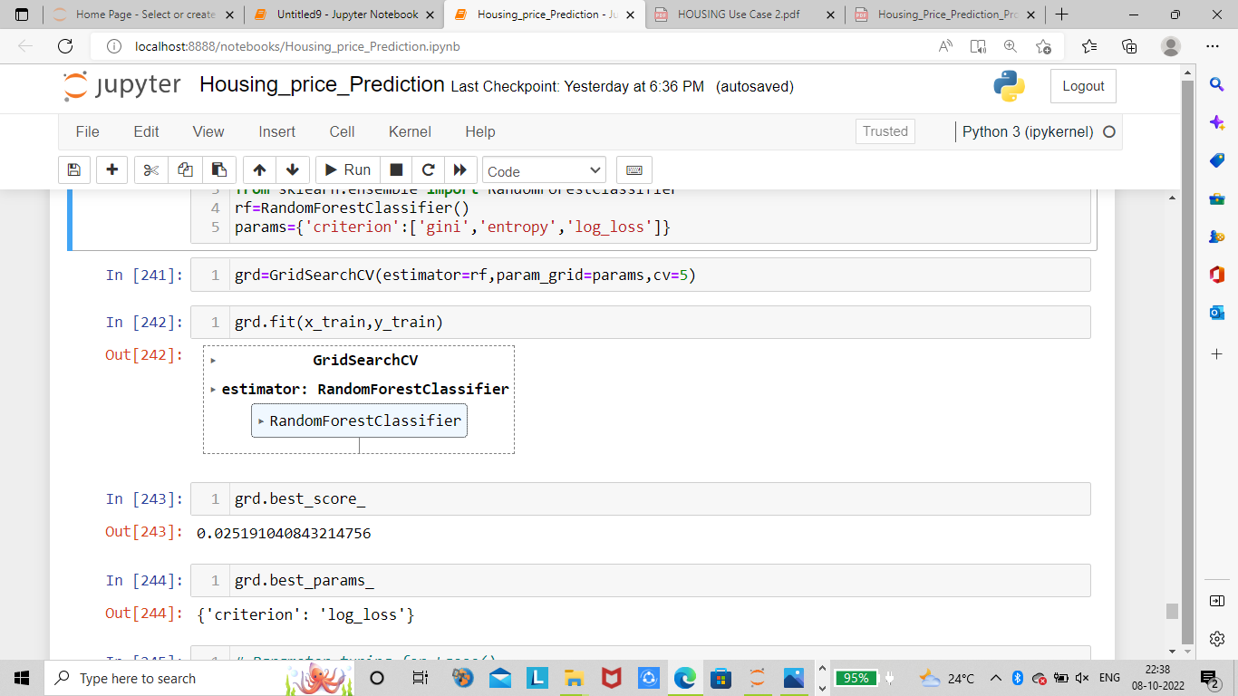
Parameter tuning on Random Forest Classifier

Slide 19
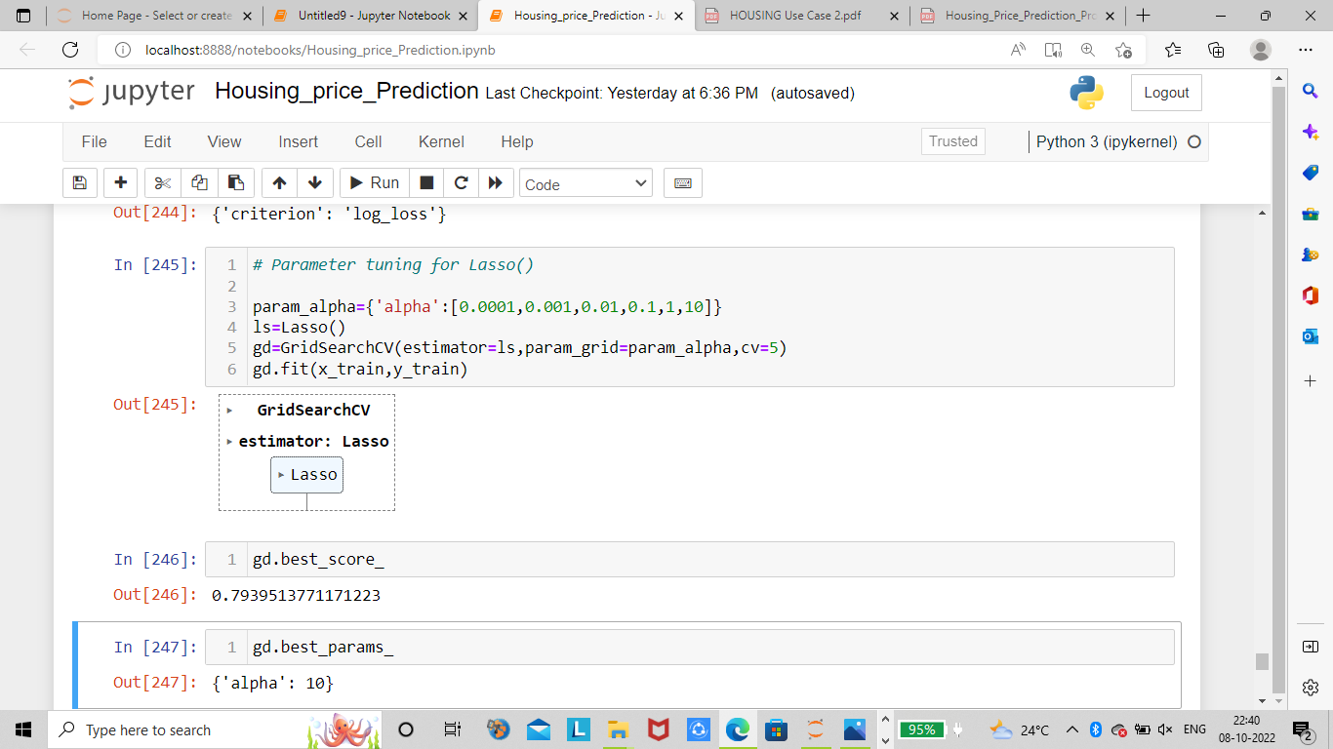
Parameter tuning on Lasso

Slide 20
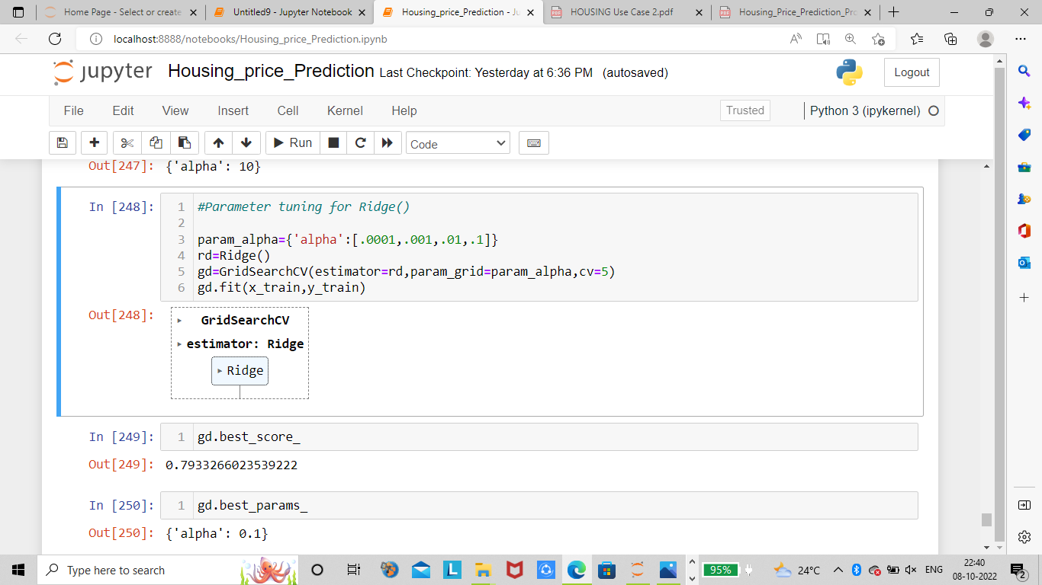
Parameter tuning on Ridge

Slide 21
Picking the Final model
By comparing all the models we built above we can consider that Lasso and Ridge are performing better with the accuracy score of 79.3%
We can pick either of these models as our final model

Slide 22
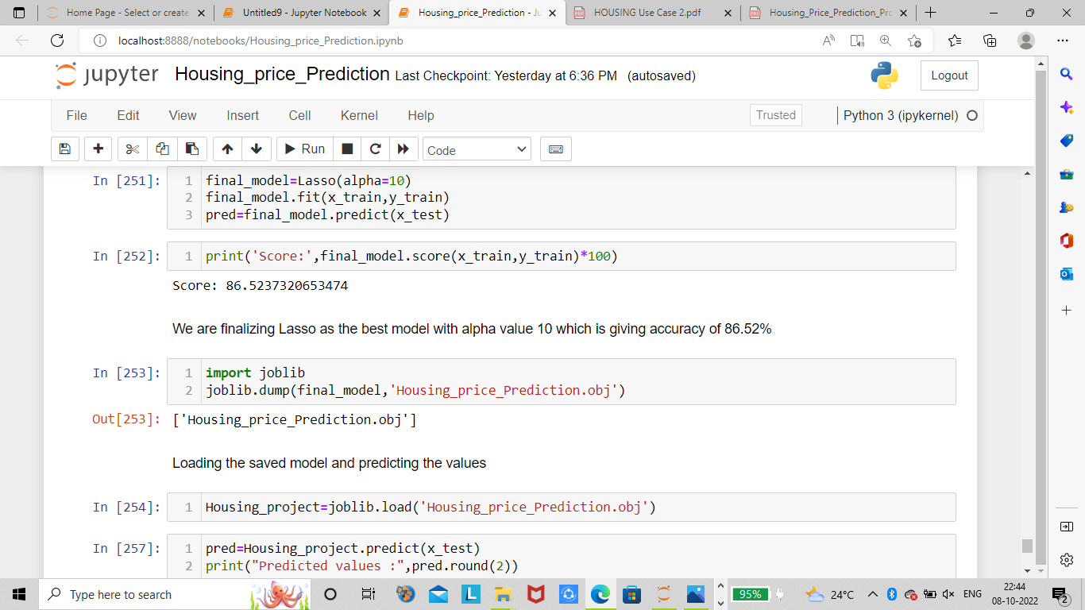
Saving the final model

Slide 23
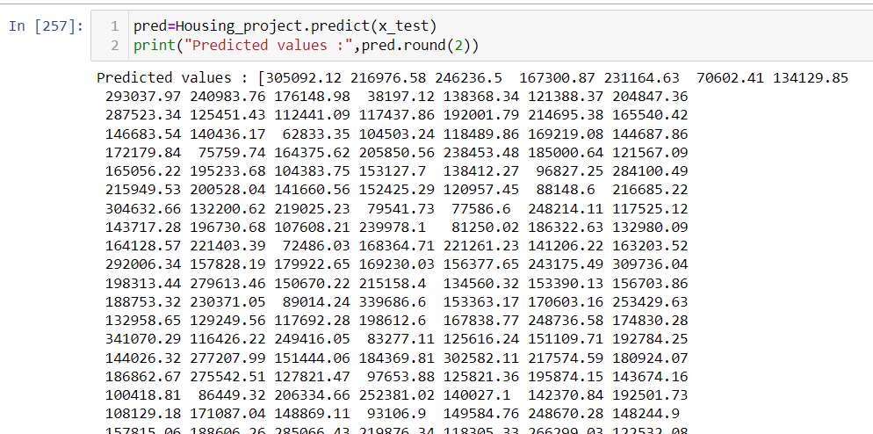
Making prediction
Score of our final model Lasso with alpha value 10 is 86.52 %

Slide 24
Conclusion
I have removed the input variable ‘Id’ as it doesn’t make any impact on output and dropped few columns like PoolQc, GarageCars, GarageCond, Exterior2nd as they were creating high multicollinearity with other variables.
The input variables like OverallQual, YearBuilt, TotalBsmtSF, FullBath, FirePlaces, GarageYrBlt, GarageArea, GrLivArea, 1stFlrSf are the variables which are highly responsible for the prediction of price as they have high correlation with output variable
The final model Lasso () is giving accuracy of 86.52% with the alpha value 10

Slide 25
THANK YOU ☺

